Slide 1


Welcome to Your Mid Year Open Enrollment!

Slide 2

It is that time of the year again..
Today we will be going over the following open enrollment topics
Your Open Enrollment To Do’s
New Benefits Enrollment Portal
The Partners’ Benefits Package -
Voluntary Life & AD&D
FSA – 1/1/2024
Wrap Up with Questions

Slide 3


Your Open Enrollment To Do’s
When Can I Enroll?
Active Open Enrollment
Please log in to the employee navigator portal to enroll in any benefits for 2023
Open Enrollment Starts:
Wednesday, Nov 1st, 2023
Open Enrollment Ends:
Friday, Nov 10th, 2023
New Benefits Effective: January 1st, 2024
What Can I Do?
Enroll, or Waive Coverage.
Add Dependents.
Update Your Address, Beneficiary, or Dependent Information.
You may not enroll or make a change outside of open enrollment unless there is a qualifying life event, which must be done within 30 days of the event. (i.e., marriage, birth, divorce, loss of other coverage)

Slide 4
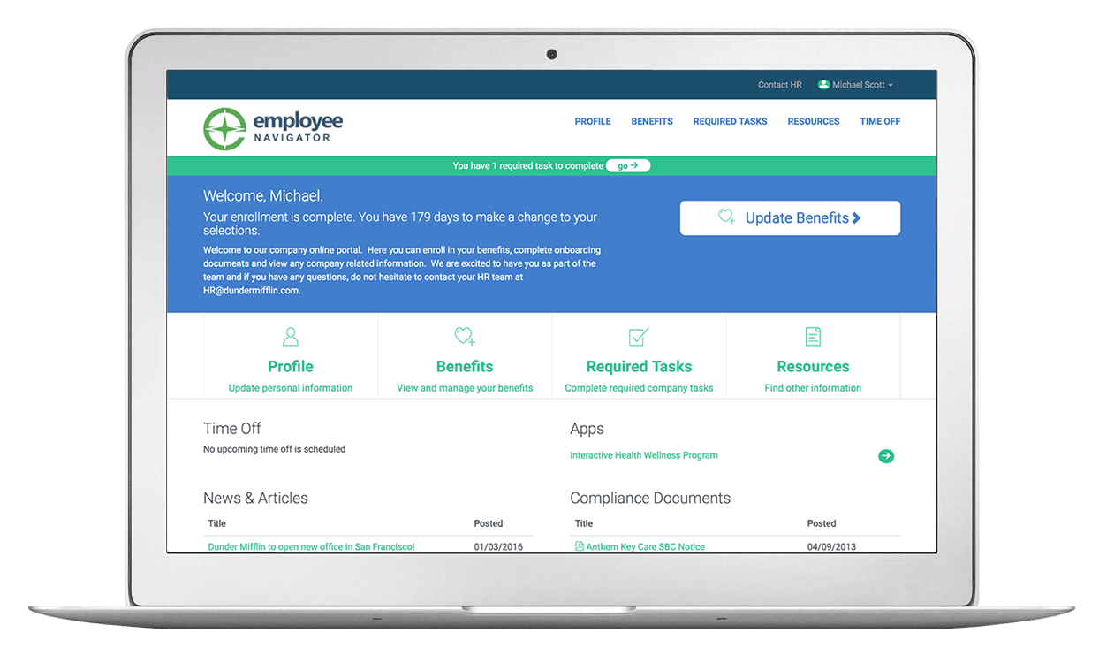


You must complete your enrollment through Employee Navigator.
The enrollment process will be broken down into 4 primary steps:
Your Information - Verify you and your dependent information is accurate and up to date. Please remember to include social security numbers for all dependents
Your Benefits - You must opt to enroll or decline each benefit. These benefits will be checked off as completed.
Your Beneficiaries - You will be asked to assign beneficiaries. Beneficiary designations must equal 100%.
Complete - After you have made your benefit elections and verified them for accuracy, click "Click to Sign.” You will want to print a copy of the Confirmation Statement for your records.
You can make changes to your selections prior to the enrollment deadline by logging back into the system and clicking on “Adjust Coverage”
Go to www.employeenavigator.com and Select Register in the upper right-hand corner to access your account
The Company ID is: PartnersBenefits
Enter your legal First and Last Name as it was provided to HR for payroll purposes.

Slide 5



Life Insurance & AD&D
Life insurance provides financial protection for your family in the event of your death. Partners offers all employees life and accidental death and dismemberment insurance through Guardian.
Basic Life and AD&D Benefit Amount:
100% Employer Paid
A cash benefit of $100,000 maximum to your loved ones in the event of your death, plus a matching cash benefit if you die in an accident.
Voluntary Life and AD&D:
You can purchase insurance for yourself in increments of $10,000 to a $500,000 maximum, amounts over $100,000 will require approval (EOI).
You can purchase coverage for your spouse in increments of $5,000 up to $250,000, any amount over $25,000 requires EOI.
You can purchase coverage in increments of $2,000 up to $10,000 for your dependent children between 14 days and 26 years old.
All coverages are subject GI and Benefit reductions at the age of 65 or older.

Slide 6


Health Care FSA – HCFSA Short Plan Year – 1/1/2024 – 7/31/2024
The Healthcare Flexible Spending Account (HFSA) provides significant savings to Employees. You can set aside funds on a pretax basis to spend on qualifying healthcare expenses throughout the plan year.
You don’t pay taxes on this money. This means you’ll save an amount equal to the taxes you would have paid on the money you set aside.
The maximum amount you can contribute for 2024 is $1,866
This is a use it or lose it benefit, you can only carry over $610 into your FSA for next year, any remaining money you will lose, so we encourage you to only contribute the amount that you think you will use in medical expenses in a year.
You can use funds in your FSA to pay for, copays, deductibles, coinsurance, prescriptions and certain medical and dental expenses for you, and the dependents under your plan. For a full list please see FSA eligible expenses.

Slide 7

Dependent Care FSA – DCFSA Short Plan Year – 1/1/2024 – 7/31/2024
A Dependent Care FSA (DCFSA) is a pre-tax benefit account used to pay for eligible dependent care services, such as preschool, summer day camp, before or after school programs, and child or adult daycare. It's a smart, simple way to save money while taking care of your loved ones so that you can continue to work.
Save an average of 30 percent on dependent care services
Reduce your overall tax burden - funds are withdrawn from your paycheck for deposit into your account before taxes are deducted
Take advantage of several convenient, no-hassle payment and reimbursement options
The maximum amount you can contribute is $2,916 with no carryover amount. You will lose the funds remaining in your account at the end of the year
Eligible Expenses:
Care for your child who is under age 13
Before and after school care
Babysitting and nanny expenses
Daycare, nursery school, and preschool
Summer day camp
Care for your spouse or a relative who is physically or mentally incapable of self-care and lives in your home

Slide 8

Employee Resources
The Partners has partnered with AP Benefit Advisors as our benefits administrator for expert assistance with benefit related questions, plan procedures, life events and claim issues.
If you require assistance, contact your dedicated Account Manager:
Natalia Bravo.
Phone: 240-618-3942
Email: Natalia.Bravo@assuredpartners.com
Resources | Group # | Web | Phone
DCHL CareFirst Kaiser UHC | 1051690 206J 50300 04w7618 | www.dchealthlink.com www.carefirst.com www.kp.org www.uhc.com | 855-532-5465 888-567-9455 866-973-4588 877-844-4999
Guardian Dental/Vision/Life/STD/LTD | 53280 | www.guardian.com | 888-567-9455
TASC HCFSA/ DCFSA | 4106-5834-9615 | www.tasconline.com | 800-422-4661

Slide 9

Questions?

